Slide 1

Jamhuriya University of Science & Technology
Faculty of Computer & IT
Lecturer: Engr. IMJamal
Web Development using React js

Slide 2
Advanced
Introduction to ES6
Regular Functions
Arrow Function
Callback function
Default Parameter Values
Function Rest Parameter
Classes
Object
Destructuring assignment
Template Literals
JSON
JavaScript Techniques

Slide 3

ES6
ES6 or ECMAScript 2015 is the 6th version of the ECMAScript programming language. ECMAScript is the standardization of JavaScript which was released in 2015 and subsequently renamed ECMAScript 2015.
ECMAScript and JavaScript are both different in nature.
it allows us to write code in a clever way which basically makes the code more modern and more readable.
ECMAScript 2015 was the second major revision to JavaScript.
ECMAScript 2015 is also known as ES6 and ECMAScript 6.

Slide 4
Cont.…
ES6 introduced several key features like const, let arrow functions, template literals, default parameters, and a lot more.
const and let
Before ES6 we mainly made use of the var keyword whenever we wanted to declare a variable. But it had some serious issues, also it was not the developers’ favorite so in the ES6 version, we were introduced to const and let keywords which allow us to store variables. They both have their own way of storing variables.

Slide 5

Cont.…
Need of ES6 was transformation/ extension in Javascript. This would definitely help to meet the demands of complex applications written in Javascript.

Slide 6
Regular Functions
A JavaScript function is a block of code designed to perform a particular task.
A function is executed when "something" invokes it (calls it).
In JavaScript function is defined with the function keyword, followed by a name, followed by parentheses ().
Function names can contain letters, digits, underscores, and dollar signs (same rules as variables).
The parentheses may include parameter names separated by commas:
(parameter1, parameter2, ...)
The code to be executed, by the function, is placed inside curly brackets: {}

Slide 7
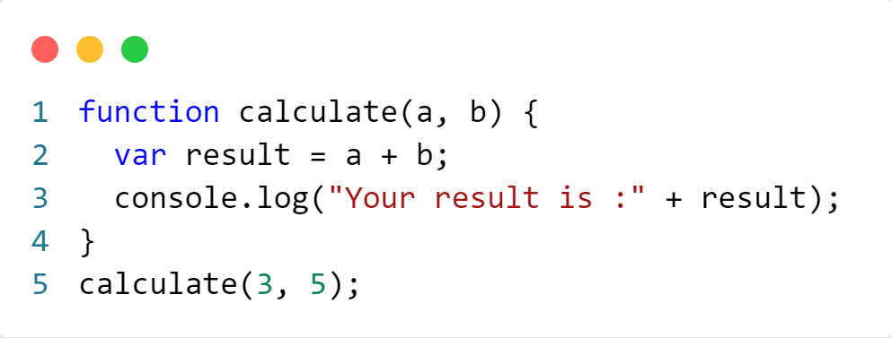
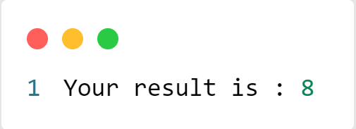
Practice 1.1
function with no return value
Output:

Slide 8
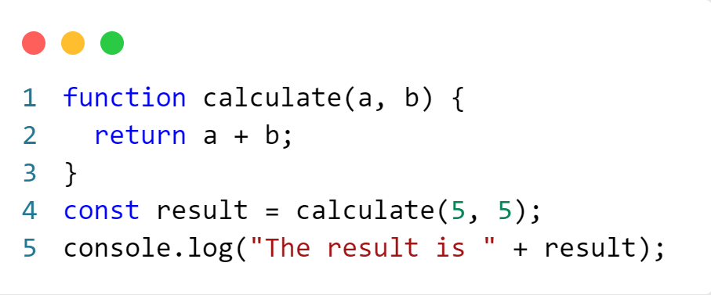
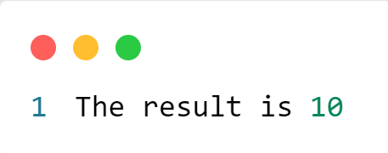
Practice 1.2
function with return value
Output:

Slide 9
Arrow Functions
Arrow functions introduced in ES6 provide a concise way to write functions in JavaScript and are handy for simple actions, especially for one-liners. They come in two flavors:
Without curly braces: (...args) => expression – the right side is an expression: the function evaluates it and returns the result. Parentheses can be omitted, if there’s only a single argument, e.g. n => n*2.
With curly braces: (...args) => { body } – brackets allow us to write multiple statements inside the function, but we need an explicit return to return something.

Slide 10

Core Advantages of Arrow Functions
Cont.…
1. Reduces code size
2. Return statement is optional for single line function
3. Functional braces are optional for single line statement
4.Lexically bind the context
Arrow functions can also be written as a more compact alternative to traditional functions, as they grant the ability to omit parentheses around parameters and add the concept of a concise function body with implicit return.

Slide 11
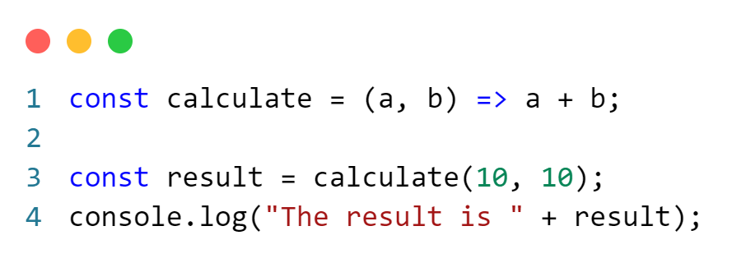

Practice 1.3
Arrow Function
Output:

Slide 12
Default Parameter Values
The term default can be understood as an option that is always available when no other options are appropriate. Similarly, a default value is a value that will always be available. In terms of computer programming language, almost every programming language has one or the other specified default values for the in-built functions or properties.
In JavaScript When no value is passed in the function definition, a default value is being set for the function definition, known as the default parameter. It allows the named parameters to get initialized with a default value when either undefined or no value is passed.

Slide 13
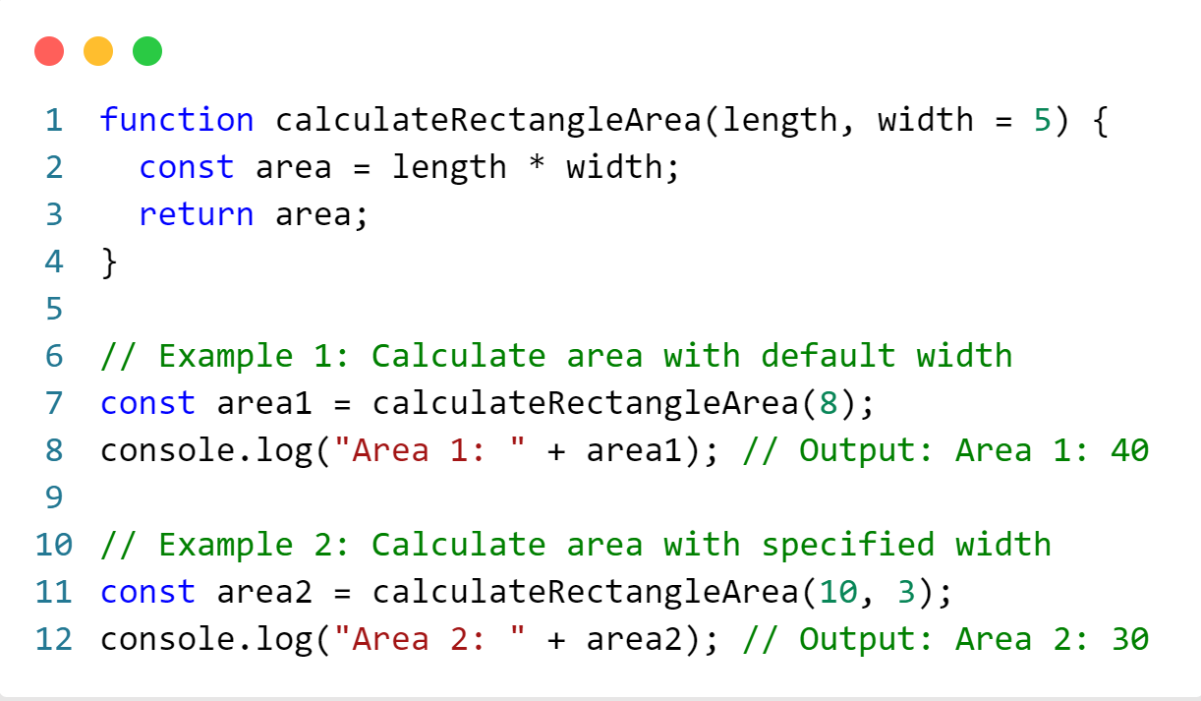
Practice 1.4
Default function parameter

Slide 14
Callback Function
A callback Function is a function passed into another function as an argument, which is then invoked inside the outer function to complete some kind of routine or action.
The main importance of a callback function is to execute a code in response to an event in a program. The event can be a simple answer to an input prompt or just a mouse click. With callback functions, a program can be written to execute a particular action in response to an event without stopping the whole application

Slide 15
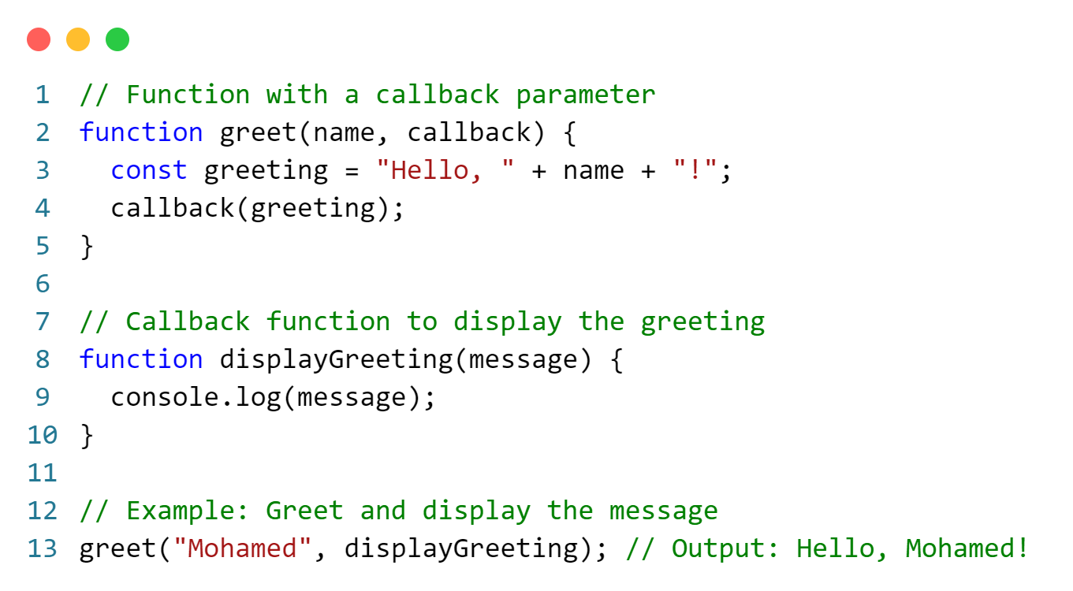
Practice 1.5
Callback Function

Slide 16
Function Rest Parameter
The rest parameter is an improved way to handle function parameters, allowing us to handle various inputs as parameters in a function. The rest parameter syntax allows us to represent an indefinite number of arguments as an array. With the help of a rest parameter, a function can be called with any number of arguments, no matter how it was defined. Rest parameter is added in ES2015 or ES6 which improved the ability to handle parameter.

Slide 17
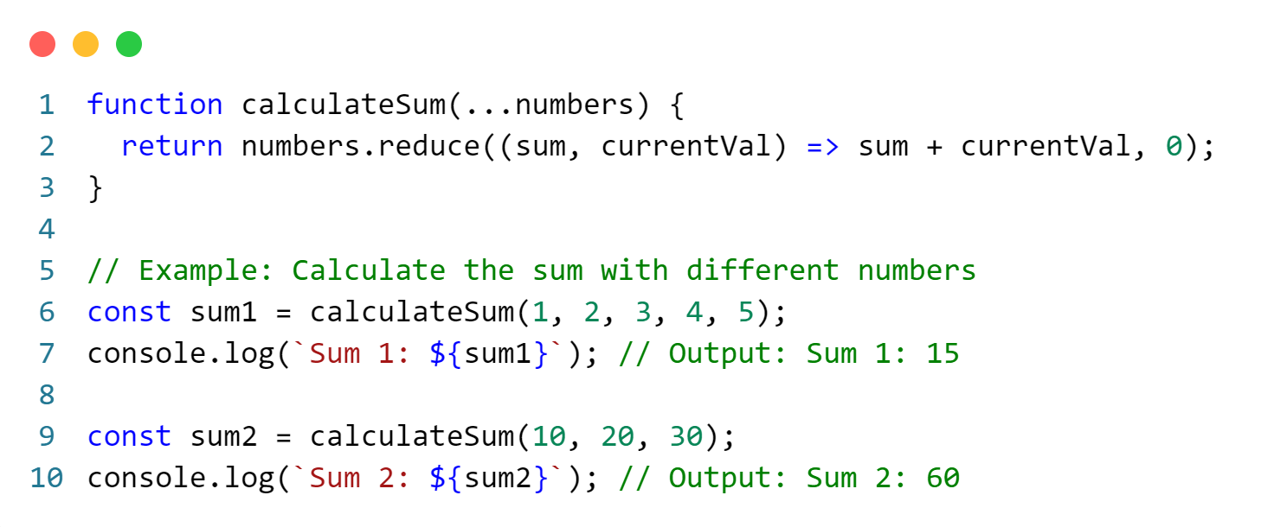
Practice 1.6
Rest parameter

Slide 18
Classes
The new version of JavaScript (ES6) introduced the use of classes instead of functions. Prior to ES6, there were only classes and, functions which are callable objects. A class in javascript is basically a blueprint or template of the object. New objects can be created from a class.
They encapsulate data with code to work on that data. Classes in JS are built on prototypes but also have some syntax and semantics that are not shared with ES5 class-like semantics.
Classes are in fact "special functions", and just as you can define function expressions and function declarations, the class syntax has two components: class expressions and class declarations.

Slide 19
Cont...
Constructor
The constructor is a special method for creating and initializing an object created with a class. There can only be one special method with the name "constructor" in a class.
A SyntaxError will be thrown if the class contains more than one occurrence of a constructor method.
It creates a new blank object.
It makes this to point to this newly created object inside the constructor function
It sets the prototype of the newly created object to the constructor function's prototype.
It makes the constructor function return the newly created object IF it is not returning anything.
Classes are similar to functions.. Unlike functions classes in JavaScript are not
hoisted. The constructor method is used to initialize. The class name is user
defined.

Slide 20
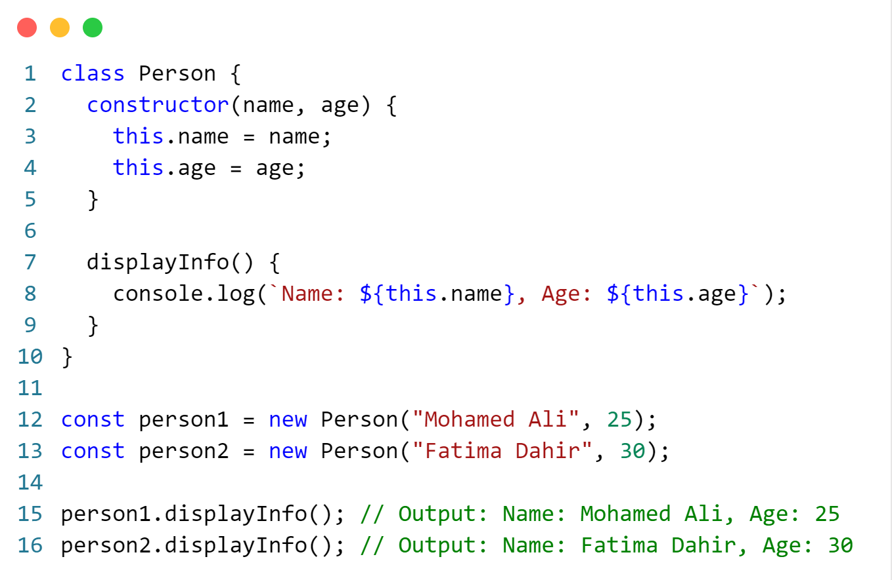
Practice 1.7
Class syntax

Slide 21
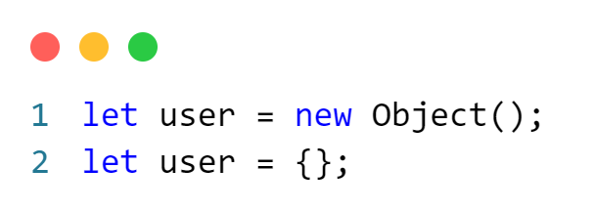
Objects
Objects, in JavaScript, are the most important data type and form the building blocks for modern JavaScript. These objects are quite different from JavaScript’s primitive data types (Number, String, Boolean, null, undefined, and symbol) in the sense that these primitive data types all store a single value each (depending on their types).

Slide 22
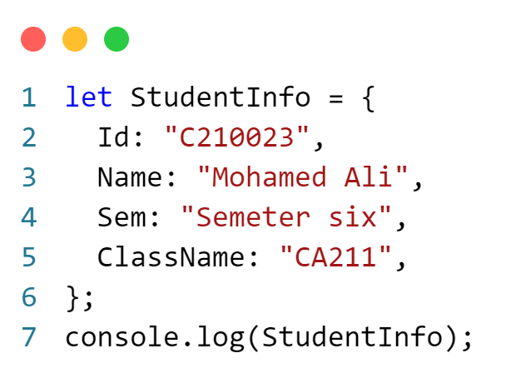
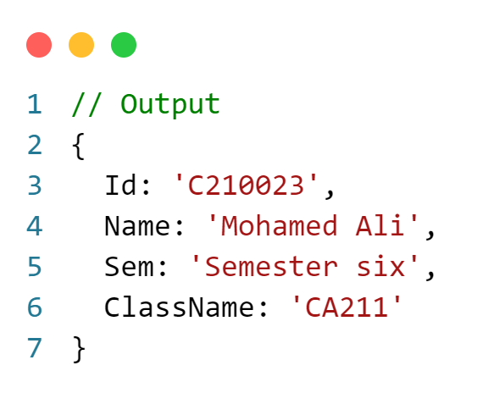
Practice 1.9
Objects:

Slide 23
Destructuring assignment
Destructuring Assignment is a JavaScript expression that allows to unpack values from arrays, or properties from objects, into distinct variables data can be extracted from arrays, objects, nested objects and assigning to variables. In Destructuring Assignment on the left-hand side defined that which value should be unpacked from the sourced variable.

Slide 24
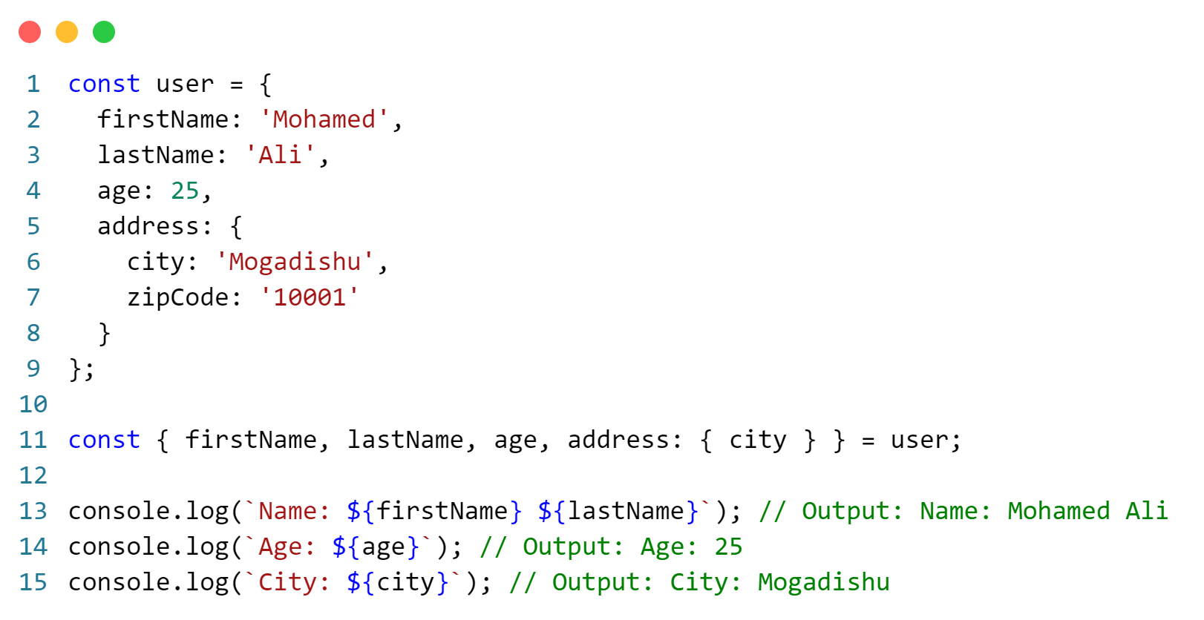
Practice 1.8
Destructuring with Objects:

Slide 25
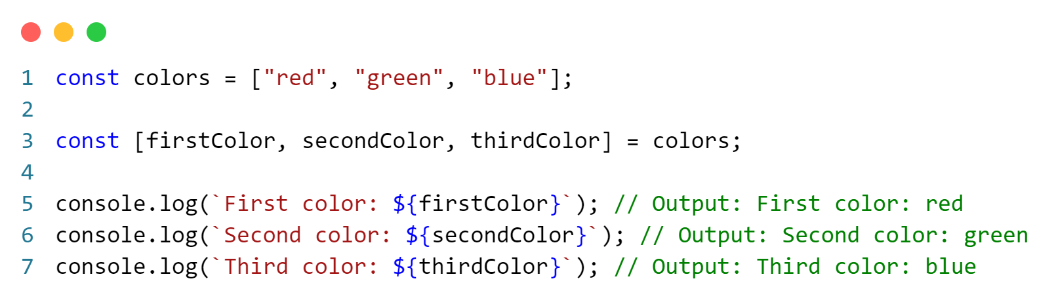
Practice 1.9
Destructuring with Arrays:
Destructuring assignment simplifies the process of extracting values from complex data structures, making the code more concise and readable. It's widely used in modern JavaScript, especially in scenarios like extracting values from function parameters or working with API responses.

Slide 26
Template Literals
Template Literal in ES6 provides new features to create a string that gives more control over dynamic strings. Traditionally, String is created using single quotes ‘ or double quotes “ quotes. Template literal is created using the backtick ` character.
Syntax:
var s=`some string`;
Automatic replacing of variables with real values is called string interpolation.

Slide 27
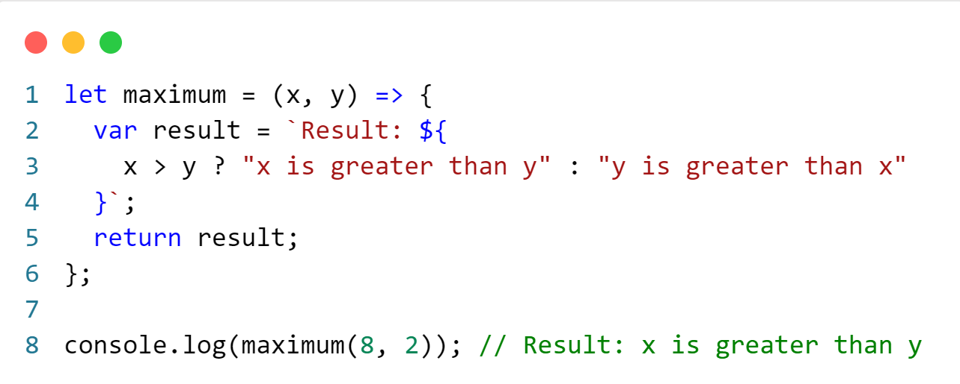
Practice 1.10
Template literals:

Slide 28
JSON
What is JSON?
JSON or JavaScript Object Notation is a format for structuring data.
It is a standard text-based format for representing structured data based on JavaScript object syntax. It is commonly used for transmitting data in web applications (e.g., sending some data from the server to the client, so it can be displayed on a web page).
JSON exists as a string — useful when you want to transmit data across a network. It needs to be converted to a native JavaScript object when you want to access the data

Slide 29
Contu….
Why JSON?
The JSON format is syntactically similar to the code for creating JavaScript objects. Because of this, a JavaScript program can easily convert JSON data into JavaScript objects.
Since the format is text only, JSON data can easily be sent between computers, and used by any programming language. Most useful methods in JSON are JSON.parse() and JSON.stringify()

Slide 30
Contu….
Characteristics of JSON
It is Human-readable and writable.
It is light weight text based data interchange format which means, it is simpler to read and write when compared to XML.
It is widely used as data storage and communication format on the web.
Though it is derived from a subset of JavaScript, yet it is Language independent. Thus, the code for generating and parsing JSON data can be written in any other programming language.

Slide 31
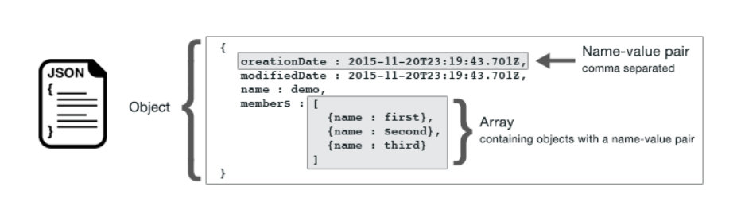
Contu….
JSON Syntax Rules
Data has to be in key/value pairs, separated by a colon.
Data pairs have to be separated by a comma.
In data pairs, the key needs to be a unique double-quoted string.
The value can be any primitive data type but never a function.
Objects are written inside curly brackets.
Arrays are written inside square brackets.

Slide 32
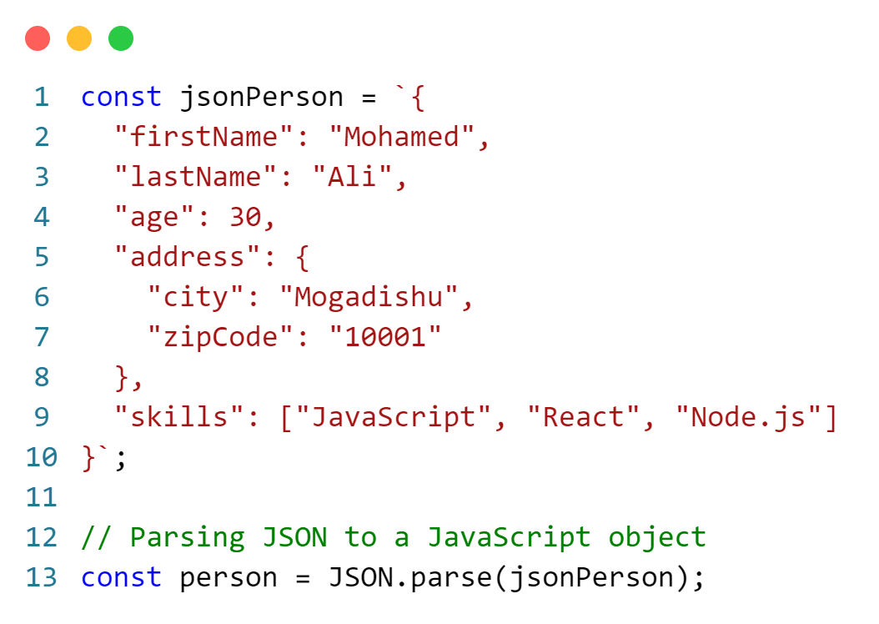
Practice 1.11
JSON to JavaScript Object

Slide 33
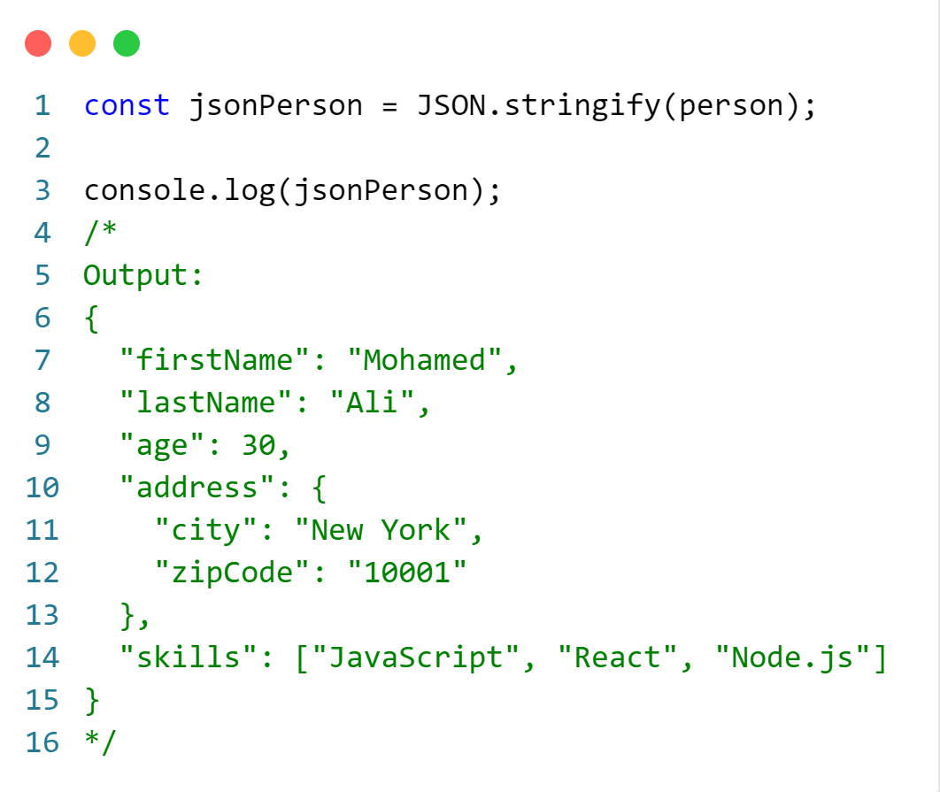
Practice 1.12
JavaScript Object to JSON

Slide 34
END.

